Slide 1
Java OOP (Object-Oriented Programming)
Topic: Introduction of Object-Oriented Programming
Learn With Mahfuz

Slide 2
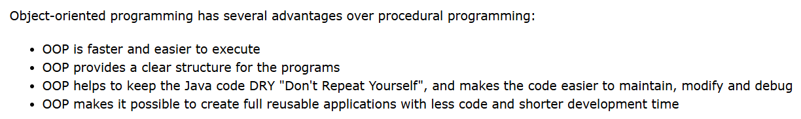
What is OOP?
Object-Oriented Programming or OOPs refers to languages that use objects in programming. Object-oriented programming aims to implement real-world entities like inheritance, hiding, polymorphism, etc in programming.

Slide 3
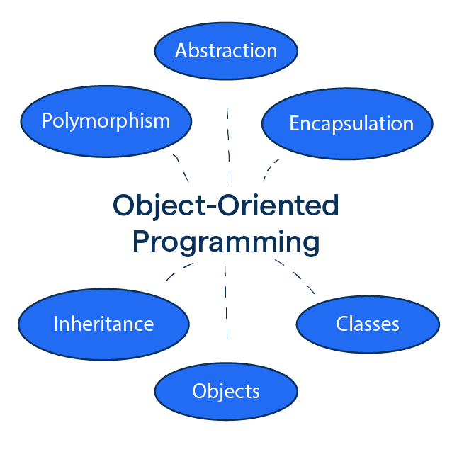
OOPs Concepts

Slide 4
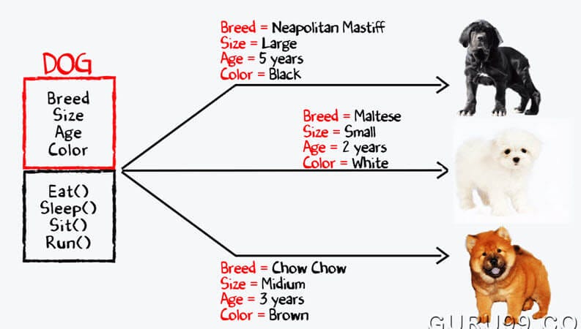
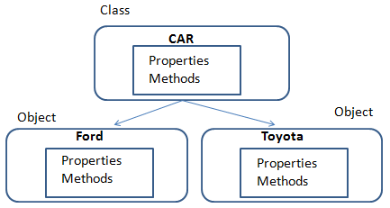
Classes and Objects
So, a class is a template for objects, and an object is an instance of a class.
When the individual objects are created, they inherit all the variables and methods from the class.

Slide 5

Click here to go to the GitHub repository

Slide 6
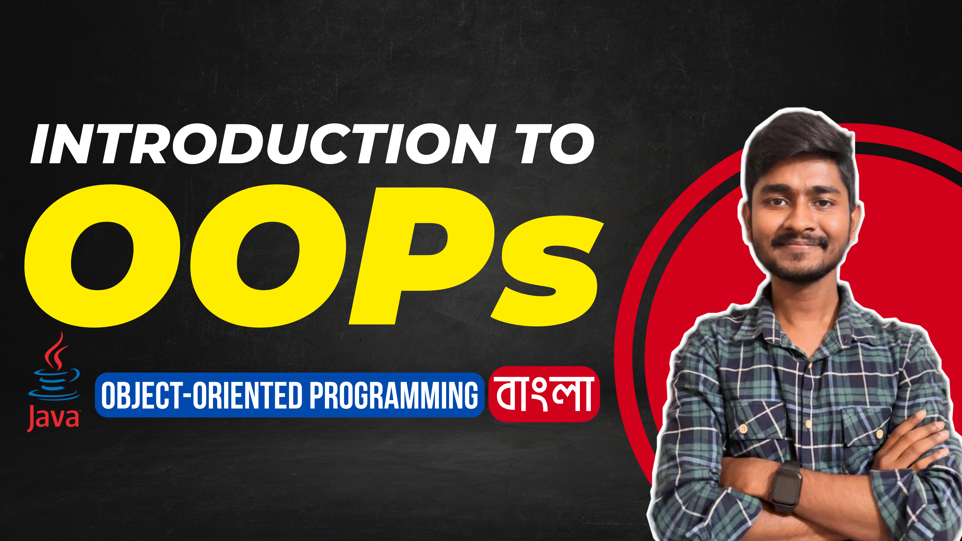
Click here to see this video!

Slide 7
THANK YOU!

